Slide 1
Relativistic Particle Acceleration in a Developing Turbulence
Shuichi MATSUKIYO
ESST Kyushu Univ.
Collaborator : T. Hada

Slide 2
Outline
Background
-- motivation
-- acceleration processes in turbulent plasmas
-- parametric instability (PI)
1D PIC simulation on PIs in a pair plasma
Acceleration mechanism : modelling
Test particle simulation
Summary

Slide 3
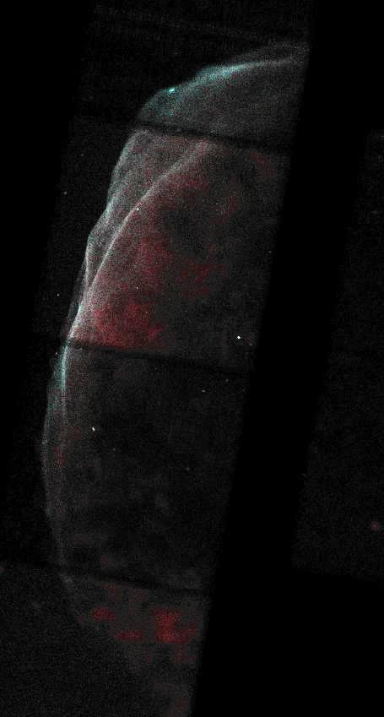
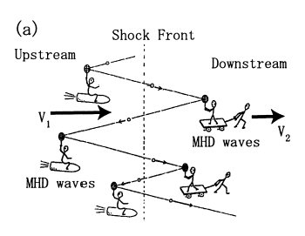
Alfven turbulence & particle acceleration
Best-known acceleration process in astrophysics :
Fermi accelerations
1st order Fermi acc. (DSA)
2nd order Fermi acc.
v⊥
v||
v₋
v₊
Scholer
SN1006
Bamba et al. [2003]

Slide 4
Alfven turbulence & particle acceleration
Best-known acceleration process in astrophysics :
Fermi accelerations
●
Standard Fermi processes take into account wave-particle interactions in ‘fully-developed’ turbulence.
●
Turbulence observed in space plasma is often coherent and time dependent.
Scales of a relaxation process may be rather large !
How is a particle acceleration process in ‘developing’ turbulence ?
SN1006
Bamba et al. [2003]

Slide 5
Parametric decays of large amplitude Alfven waves
Resonance conditions :
ω_{p} + ω₁ = ω_{2,3}
k_{p} + k₁ = k_{2,3}
decay inst.
ω
Alfven
D3
P
acoustic
D2
D1
k

Slide 6
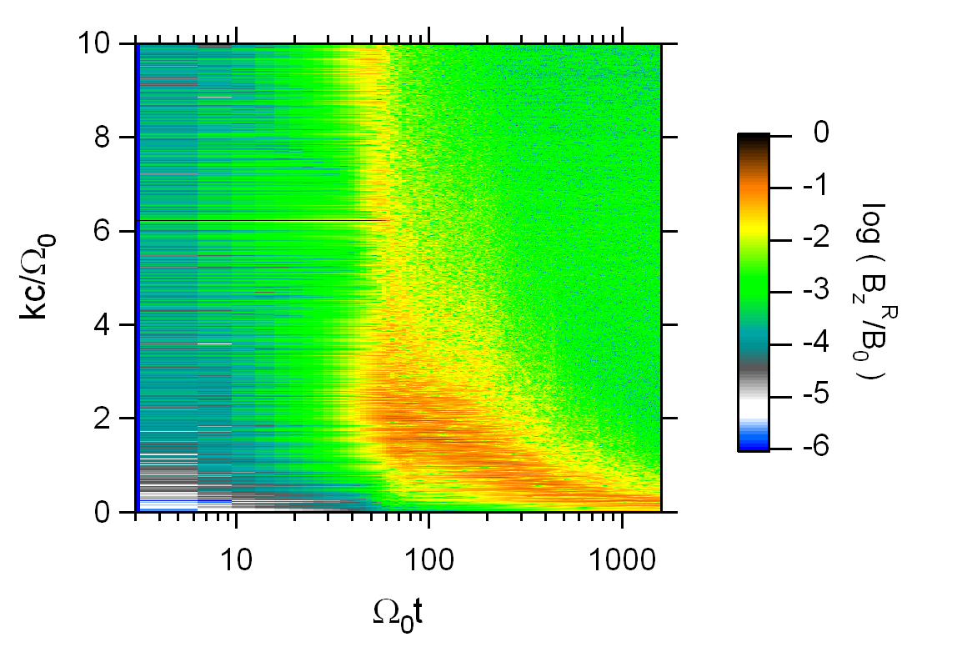
1D PIC sim. on parametric inst. in a pair plasma
k
Amplitude spectrum of B
x
(|| B₀)
P
RH circularly polarized
parent Alfven wave :

Slide 7
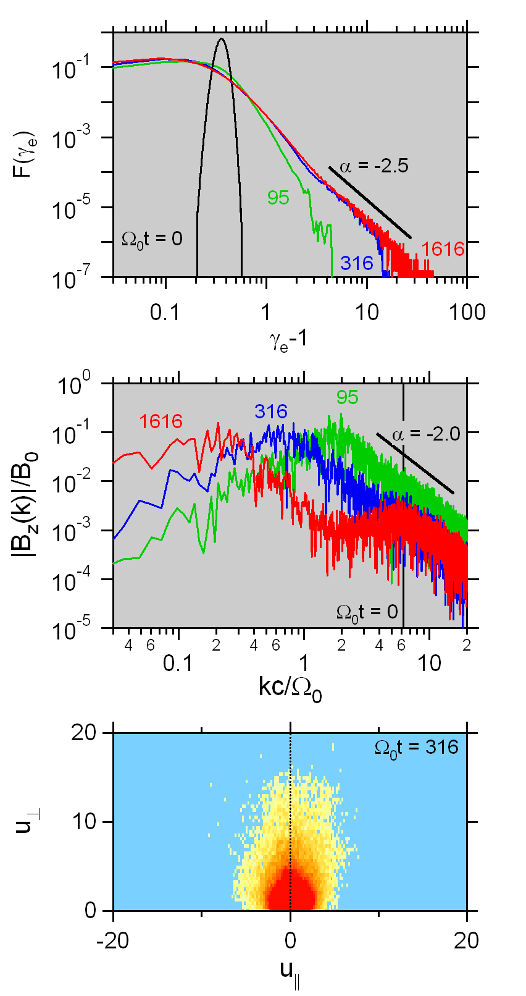
1D PIC sim. on parametric inst. in a pair plasma
Electron energy & momentum dist.

Slide 8
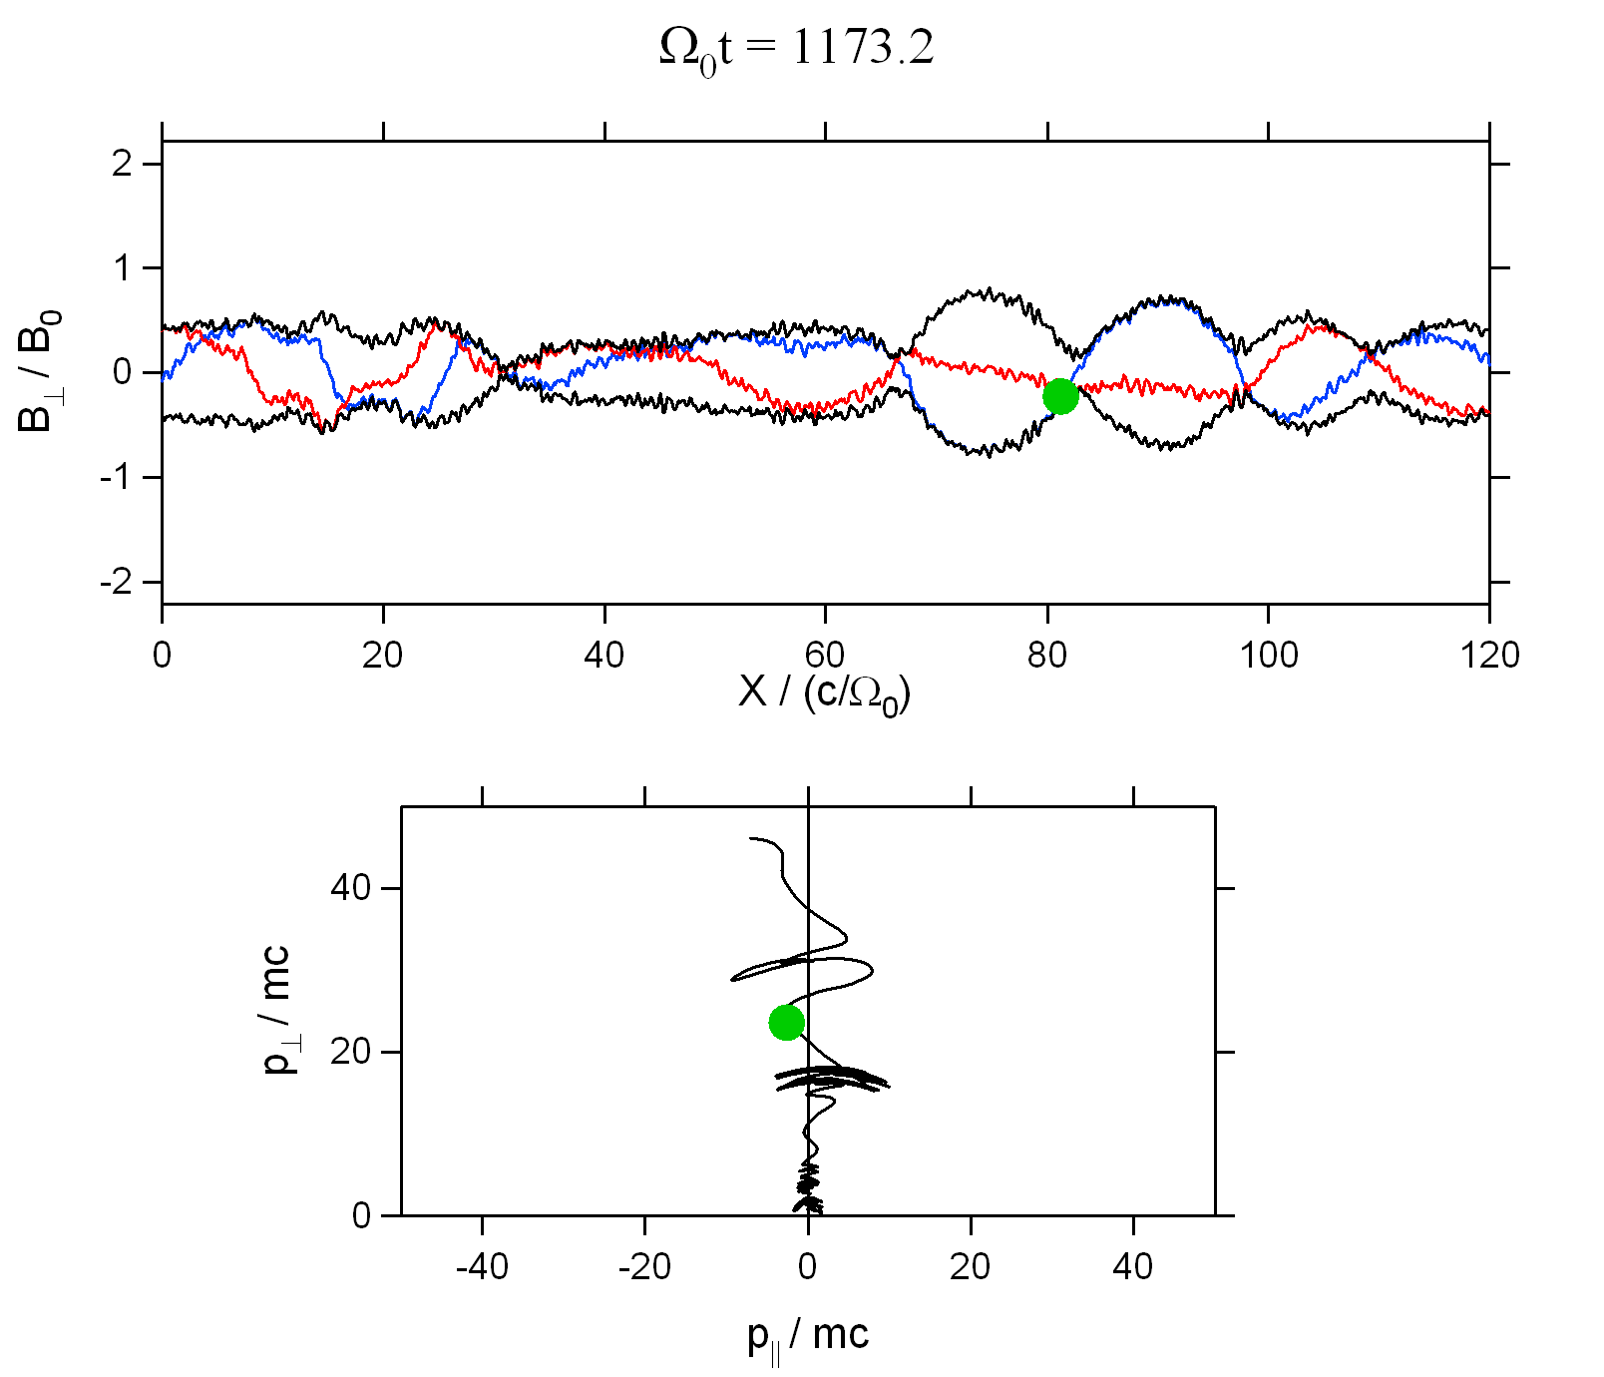
Acceleration mechanism
Assumption:
Two waves with opposite
signs of k (same ω) locally
become dominant.
trapping by a
sharp envelope
trough
(ω,k)
(ω,-k)

Slide 9
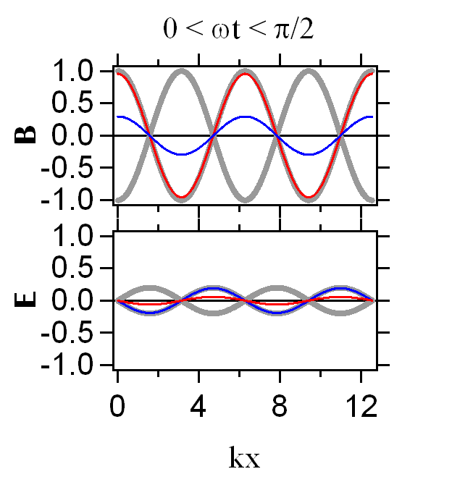
Motion of an electron
where
fixed point
Assumption:
u|| , x = const. ➔
u_{||(⊥)} = p_{||(⊥)} / m₀c

Slide 10
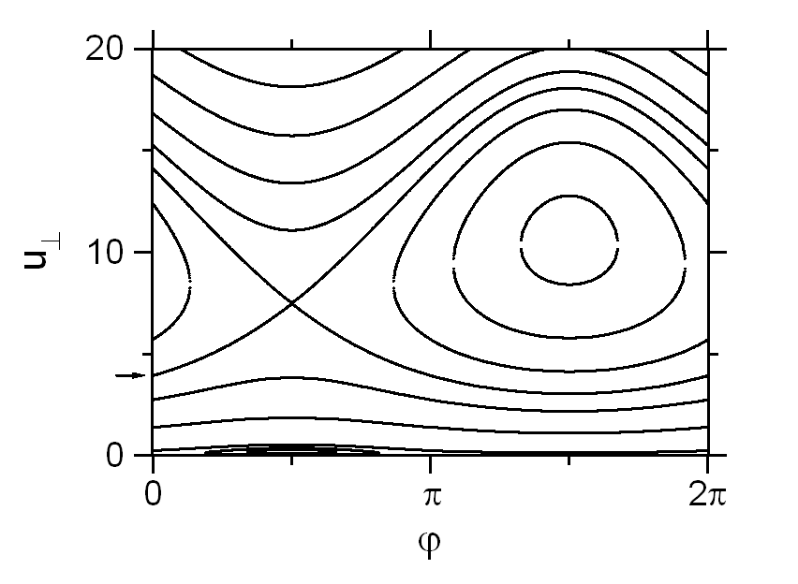
Trajectory in u⊥ - ϕ space
Relativistic trapping
In small amp. limit:
ω ~ Ω₀ /γ
NR
u⊥
NR
u||
u_{res-}
u_{res+}
Nonresonant trapping
Finite amp. is necessary.
Also seen in nonrelativistic limit.

Slide 11
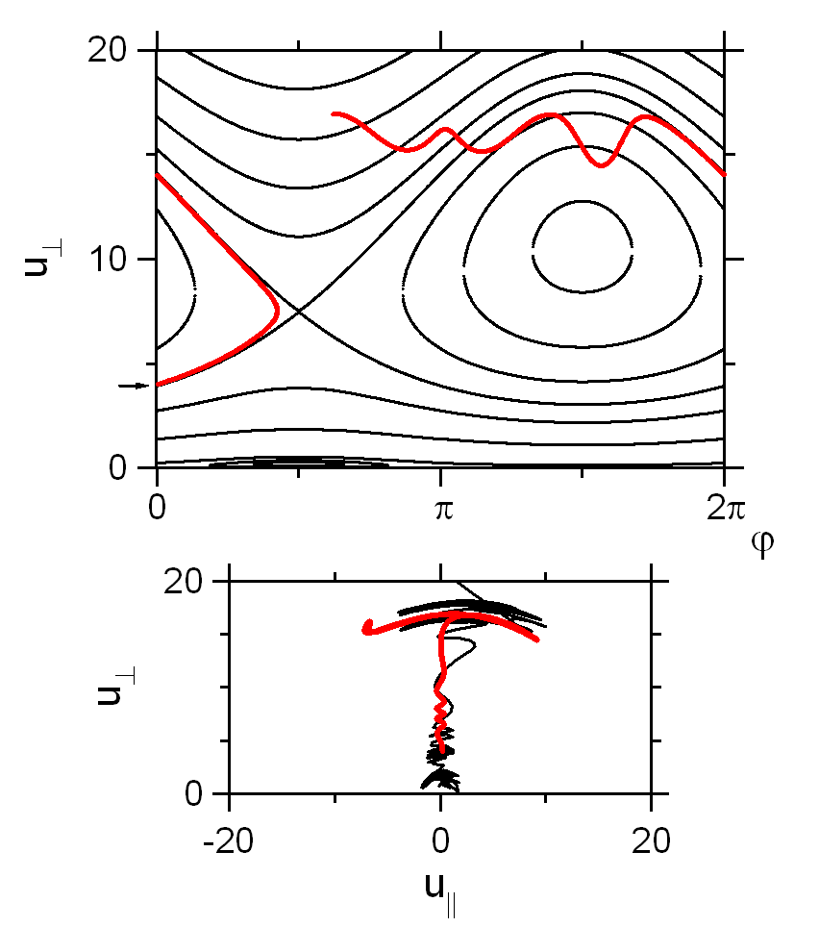
Trajectory in u⊥ - ϕ space
Max. u⊥
Comparison with sim.

Slide 12
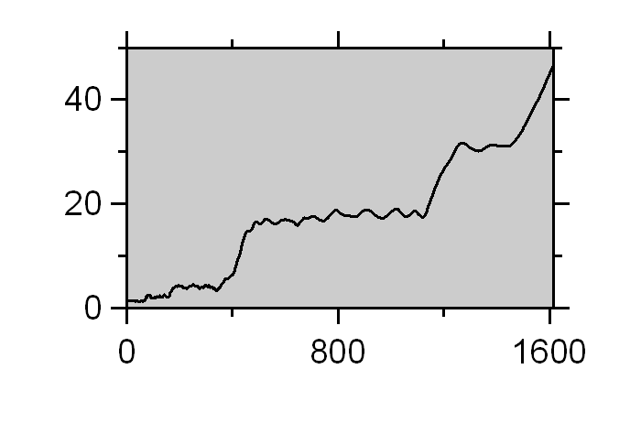
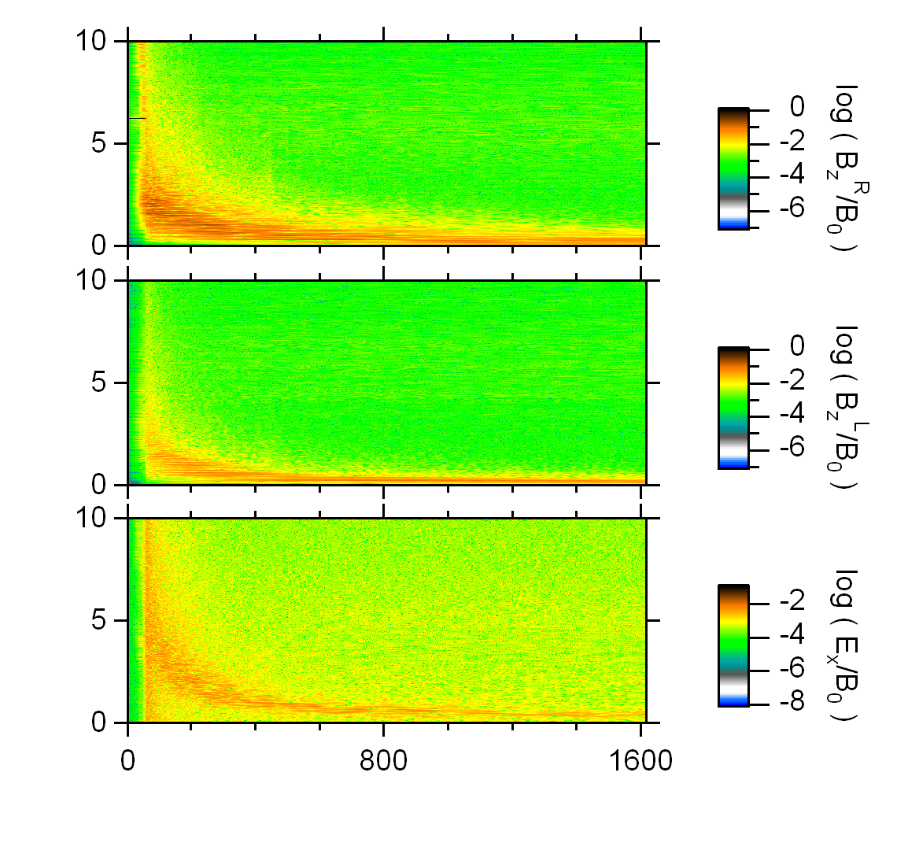
Preferential acc. of high energy particles
Time variation of
electron energy
resonance cond.
γ_{e}
ω (k)
Ω₀/γ
t
Ω₀t
kc/Ω₀
Log|B_{z}^{R}/B₀|
Ω₀t

Slide 13
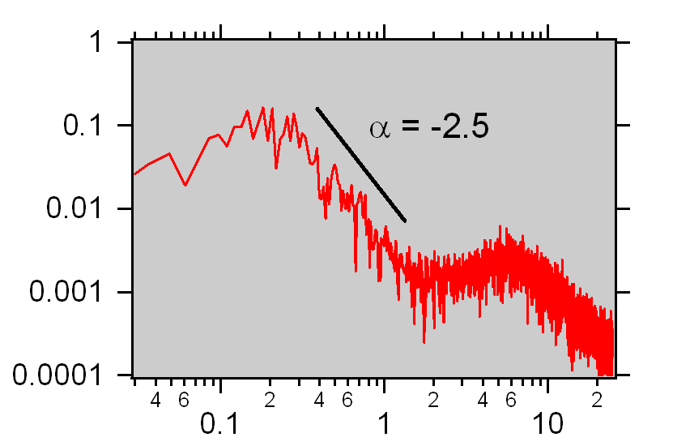
How essential in particle acc. is the relativistic effects ?
Test particle simulation
B_{w}(k)
1
- α
Wave amp. spectrum at Ω₀t = 1616
±k
K₀=0.1 3.0
-2.0
ω
|B(k)|/B₀
k
kc/Ω₀
-3 3

Slide 14
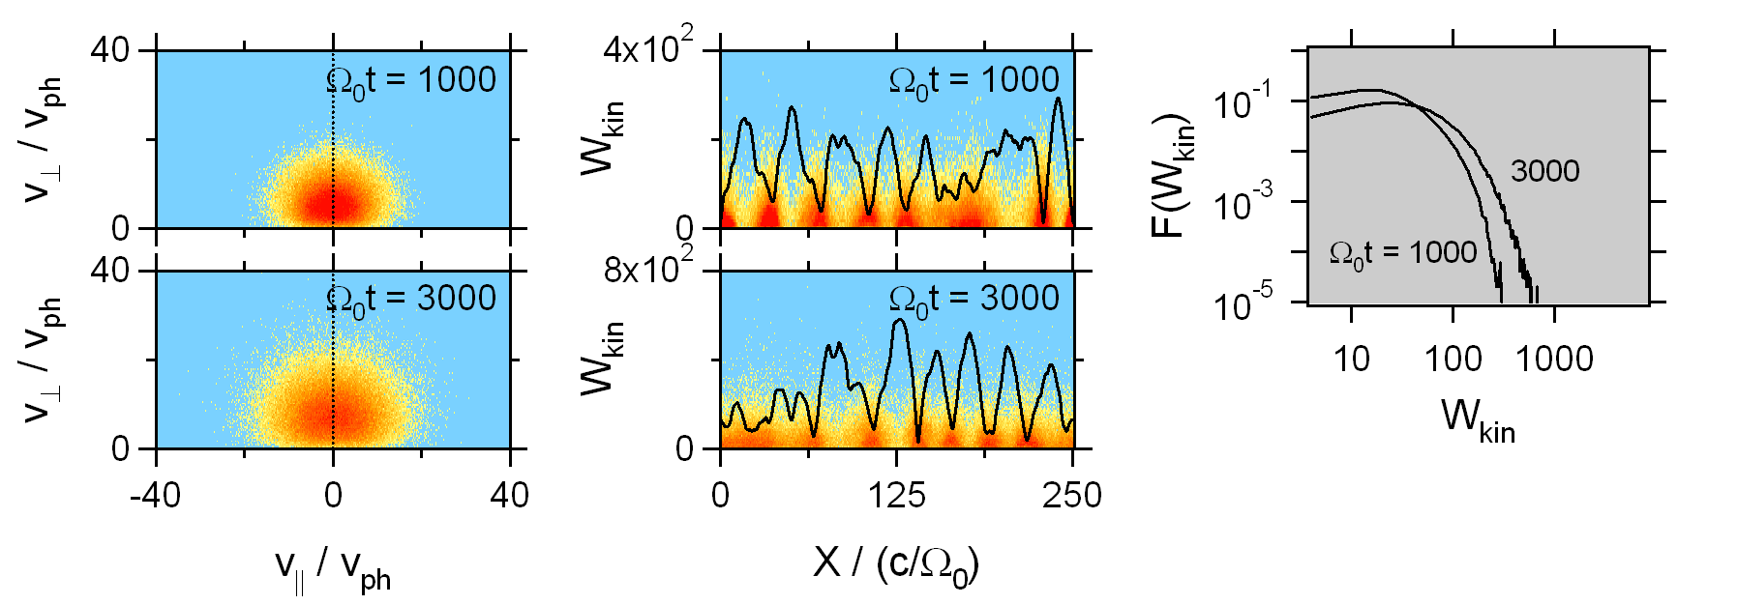
Test particle simulation
Non-rel. & Rel. eqs. of motion for 10⁵ particles
Initial distribution function: isotropic ring with v⊥/c = 0.1
Non-relativistic case

Slide 15
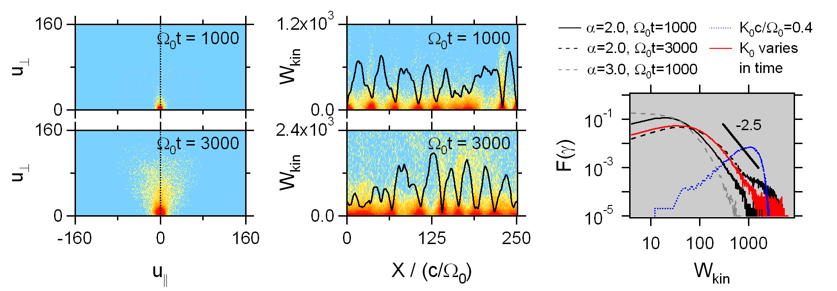
Test particle simulation
Non-rel. & Rel. eqs. of motion for 10⁵ particles
Initial distribution function: isotropic ring with v⊥/c = 0.1
Relativistic case

Slide 16
Summary
Particle acceleration process through coherent Alfven
waves in the course of parametric decay instabilities :
1D PIC simulation
Local sharp envelope troughs of magnetic fields
Relativistic perp. acceleration of particles trapped in the envelope troughs
Preferential acceleration of high energy particles
Model analysis & test particle simulation
Motion of a particle in two oppositely propagating waves
Relativistic resonance with the two waves
Maximum attainable energy consistent with the PIC simulation
Test particle simulation reproduced power-law like tail when the time varying wave spectrum is assumed.

