Slide 1



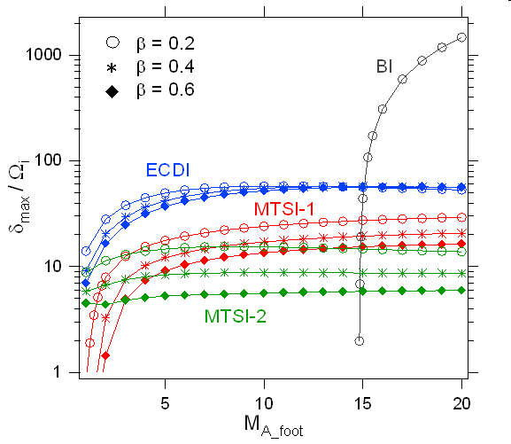
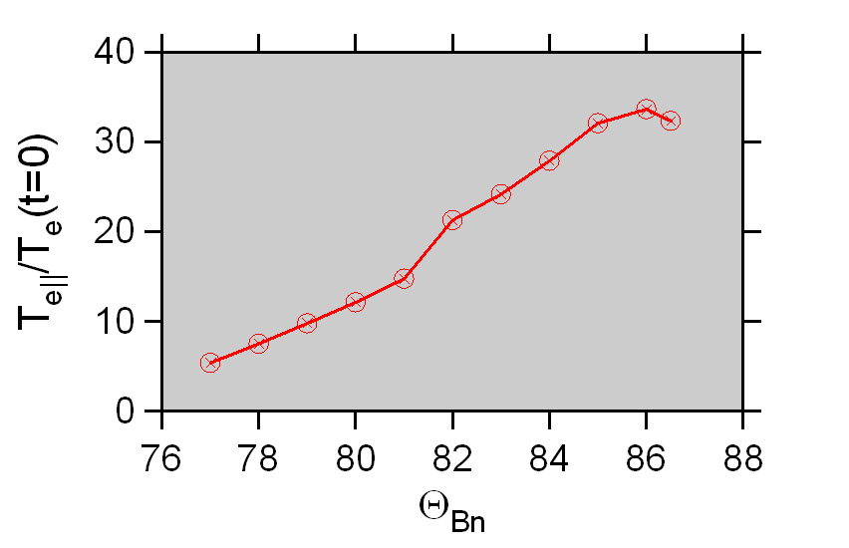
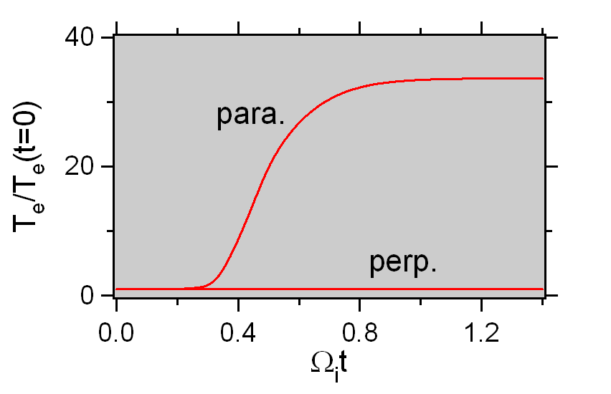
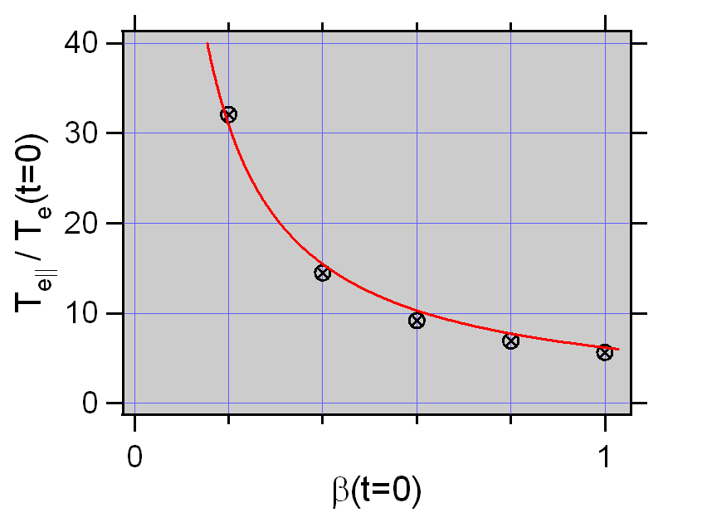
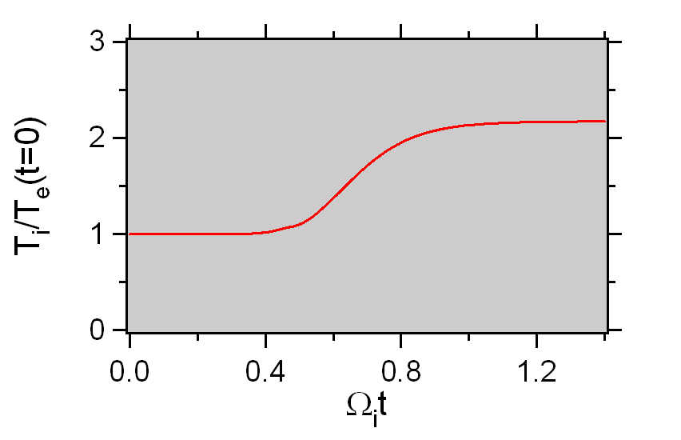
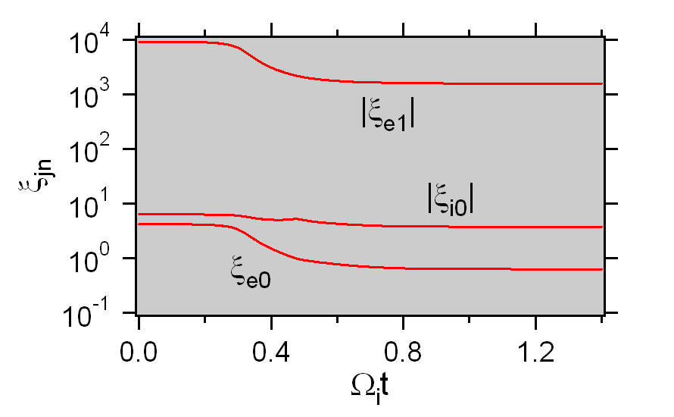
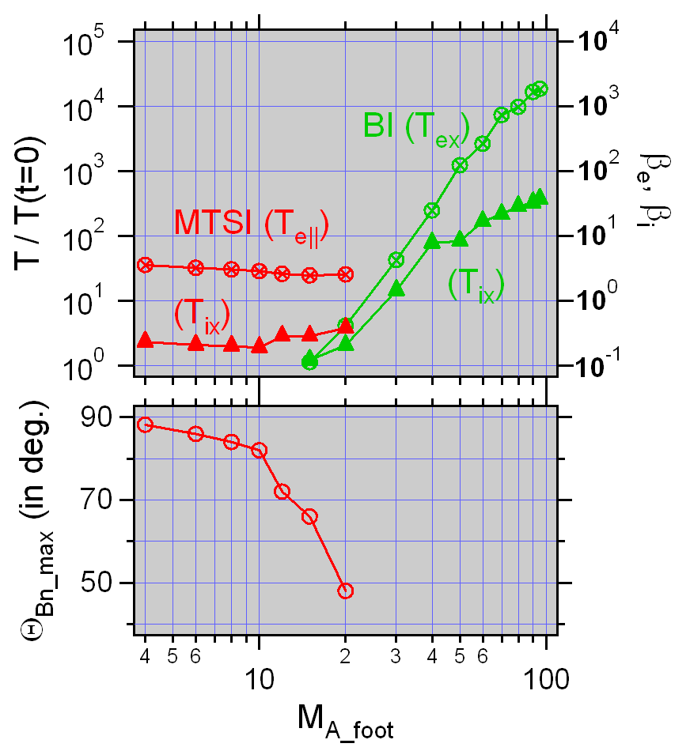
Krakow2008/10/5-9
Quasilinear Analysis on Electron Heating
in a Foot of a High Mach Number Shock
Shuichi MATSUKIYO
ESST Kyushu University (E-mail: matsukiy@esst.kyushu-u.ac.jp)
Abstract
In a transition region of a high Mach number quasi-perpendicular shock the presence of ref-lected ions leads to a variety of micro-instabilities. Heating processes of electrons have not been paid much attention in contrast to some acceleration processes producing non-thermal populations. In this study quasilinear heating of electrons through microinstabilities in a shock transition region is investigated. An evolution equation of kinetic energy obtained by taking the second order moment of the Vlasov equation under the quasilinear assum-ption is numerically solved to discuss a satu-ration level of electron temperature. Depen-dencies of electron heating rate on types of instabilities and upstream plasma parameters are reported.
Background & Motivations
A variety of micro-instabilities are ge-nerated in a shock transition region, while not much attention was paid to saturation levels of the instabilities.
u_{i}
shock
F(u_{x})
u_{e}
x
u_{r}
u_{r}
u_{e}
u_{i}
u_{x}
Chandra image of SN1006
Understanding electron heating ra-te near a shock is one of the outsta-nding issues of a collisionless shock physics. For instance, strong heati-ng may occur in SNR shocks, while significant heating is seldom obser-ved near the earth. Why?
Electron heating rates for wide ran-ge of shock parameters are discuss-ed by using a quasilinear (QL) anal-ysis in this study.
Growth rates of various microinstabilities
ω
upper hybrid
～
～
BI
electron
Bernstein
～
～
γ_{max}
ECDI
oblique
whistler
MTSI
k
MTSI = modified two-stream inst.
BI = Buneman inst.
Approach
Time evolution of kinetic energies are obtained by taking the second order ( v²) moments of .
In addition, evolution of wave energy:
and conservation of total energy:
form a closed set of evolution equations of the system.
ω is obtained in each time step by using ‘emdisp’ which is a dispersion solver for a hot plasma with (shifted-) Maxwellian distribution functions.
QL evolution of a distribution function:
Results
kc/ω_{pe} = 1 (fixed)
MTSI for M_{A_foot} = 6
Averaged in k
The following parameters
are fixed if not specified.
Electron heating rate is inversely proportional to initial beta, which means that saturation electron temperature does not depend on the initial beta.
m_{i} /m_{e} = 1836
(ω_{pe} /Ω_{e})² = 10⁴
β(t = 0) = 0.2 (β_{e} = β_{i})
ion reflection ratio:
α = n_{r} / n_{i} = 1 / 3
~ β ⁻¹
Effects of kinetic damping
Electron Landau damping is the most efficient as pointed out in the past study by SM & Scholer [2003, JGR].
M_{A_foot} dependence of saturation temperature
(comparison between MTSI and BI)
Strong parallel elec-
tron heating
(almost constant T_{e⊥})
T_{e||} /T_{i} >>1
β_{e||} less depende-
nt on M_{A_foot} for
MTSI
β_{ex} increases with
M_{A_foot} for BI
|ξ_{e0}|~1 : elec. Landau damping
|ξ_{e1}|~1 : elec. cyclotron damping
|ξ_{i0} |~1 : ion Landau damping
MTSI dominant for
M_{A_foot} ≤ 20 ~ 30
BI dominant for
M_{A_foot} ≥ 20 ~ 30
Summary
Electron heating rate through microinstabilities in a foot of a high Mach number
quasiperpendicular shock was discussed by solving moment equations of a QL
Vlasov-Maxwell system.
Strong elec. heating parallel to B₀ due to MTSI for M_{A_foot} ≤ 20 ~ 30.
Strong elec. heating parallel to beam due to BI for M_{A_foot} ≥ 20 ~ 30.
Main electron heating mechanism is Landau damping for both MTSI and BI.
Saturation levels of β_{e} for MTSI are typically ~ O(1) which is often the same level
as the value of the solar wind.
Saturation level of β_{e} at M_{A_foot} = 100 for BI exceeds 10³ and T_{e} / T_{i} ~ 50.
Saturation temperature for MTSI does not depend much on M_{A_foot}. This may be related with Θ_{Bn} dependence of EM/ES ratio of oblique whistler waves. The ratio rapidly increases as Θ_{Bn} deviates from 90^{ο} [Wu et al., 1983, PoF].

